Slide 1
PROJECT TITLE
CAPSTONE PROJECT
Presented By:
Student Name: MANIKANDAN G
College Name: KINGS ENGINEERING COLLEGE
Department:INFORMATION TECHNOLOGY

Slide 2
OUTLINE
Problem Statement (Should not include solution)
Proposed System/Solution
System Development Approach (Technology Used)
Algorithm & Deployment
Result (Output Image)
Conclusion
Future Scope
References

Slide 3
Problem Statement
In today's digital age, where cybersecurity threats loom large, one of the significant concerns is the proliferation of keyloggers, stealthy software tools designed to monitor and record keystrokes on a user's computer without their knowledge. Keyloggers pose a severe threat to individuals and organizations as they can capture sensitive information such as passwords, credit card details, and other personal data, leading to identity theft, financial loss, and privacy breaches.

Slide 4
Proposed Solution
Data Collection:
Gather data on keypress events, including timestamps and types of keys pressed.
Optionally, collect additional contextual data such as application usage, user activity, and system events.
Data Preprocessing:
Clean and preprocess the collected data to handle any anomalies or inconsistencies.
Perform feature extraction to derive meaningful insights from the raw keypress data, such as frequency of specific key usage or patterns in typing behavior.
Machine Learning Algorithm:
Implement machine learning techniques to analyze the keypress data and identify patterns or anomalies.
Consider using algorithms such as anomaly detection, clustering, or classification to detect suspicious or unusual typing behavior.
Deployment:
Develop a user-friendly interface or dashboard for monitoring and analyzing keylogging data.
Ensure the deployment platform provides secure access controls and encryption mechanisms to protect sensitive user information.
Evaluation:
Evaluate the performance of the keylogger system based on metrics such as detection accuracy, false positive rate, and system resource usage.
Continuously monitor and update the keylogger system to adapt to evolving typing patterns and security threats.

Slide 5
System Approach
Data Collection:
Ability to capture keypress events, including timestamps and types of keys pressed.
Optional collection of additional contextual data such as application usage, user activity, and system events.
Data Processing:
Processing power sufficient to handle real-time data collection and preprocessing.
Efficient algorithms for cleaning and preprocessing the collected data to handle anomalies or inconsistencies.
Adequate storage capacity to store keylogging data securely.
Machine Learning:
Access to machine learning libraries for implementing algorithms to analyze keypress data.
Resources for model training, evaluation, and optimization.

Slide 6
Algorithm & Deployment
Algorithm Selection:
The chosen algorithm for detecting anomalous keylogging behavior is an anomaly detection algorithm. Anomaly detection is well-suited for identifying unusual patterns or outliers in data, which aligns with the objective of detecting suspicious or unauthorized keyboard activity.
Data Input:
The algorithm utilizes the following input features:
Timestamps: Capturing the time of keypress events to analyze temporal patterns.
Key types: Identifying the specific keys pressed to detect unusual typing behavior.
Training Process:
The algorithm is trained using historical keylogging data containing both normal and anomalous keypress patterns.
During training, the algorithm learns to distinguish between normal typing behavior and anomalous events by identifying patterns in the input features
Prediction Process:
Once trained, the algorithm can make predictions for future keylogging events in real-time.
During the prediction phase, the algorithm analyzes incoming keypress data and compares it against the learned patterns from the training phase.

Slide 7
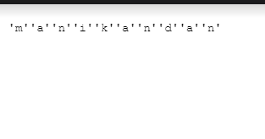
OUTPUT:

Slide 8
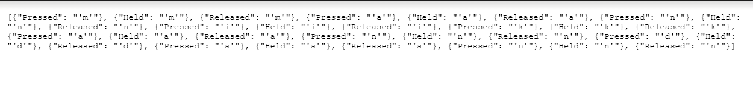
Result

Slide 9
Conclusion
In conclusion, the development of a keylogger system presents a robust solution for monitoring and analyzing keyboard activity, with a focus on security and anomaly detection. By leveraging advanced techniques in data collection, preprocessing, and machine learning, the system can effectively detect and respond to suspicious or unauthorized keylogging behavior in real-time

Slide 10
Future scope
Discuss potential enhancements and expansions for the system. This could include incorporating additional data sources, optimizing the algorithm for better performance, and expanding the system to cover multiple cities or regions. Consider the integration of emerging technologies such as edge computing or advanced machine learning techniques.

Slide 11
References
List and cite relevant sources, research papers, and articles that were instrumental in developing the proposed solution. This could include academic papers on bike demand prediction, machine learning algorithms, and best practices in data preprocessing and model evaluation.

Slide 12
THANK YOU

